Slide 1

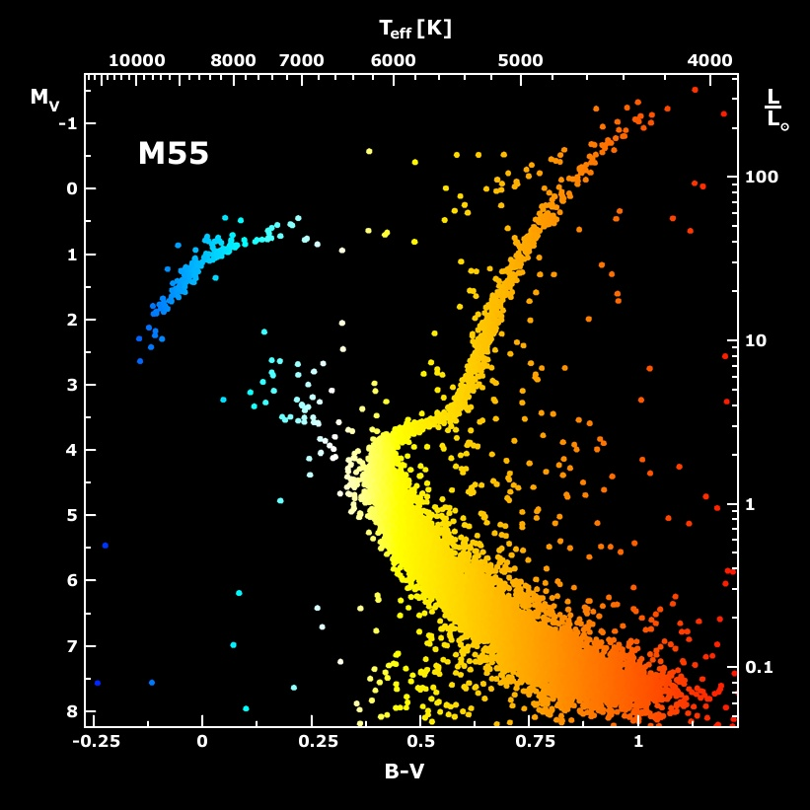
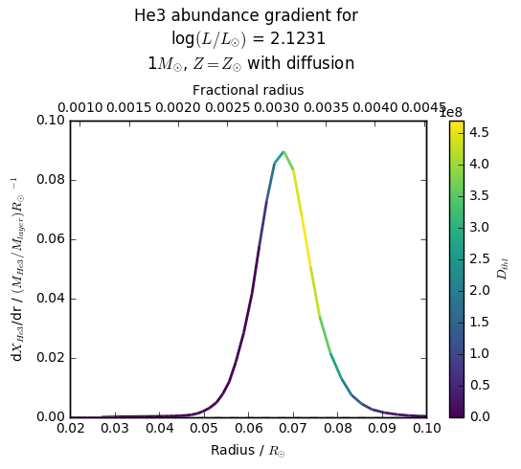
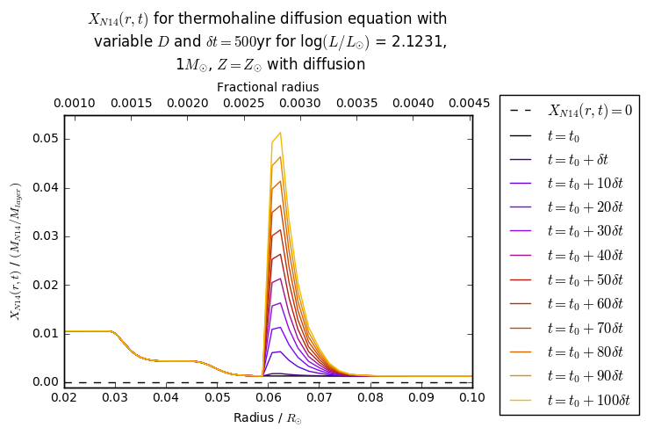
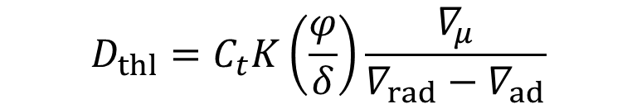


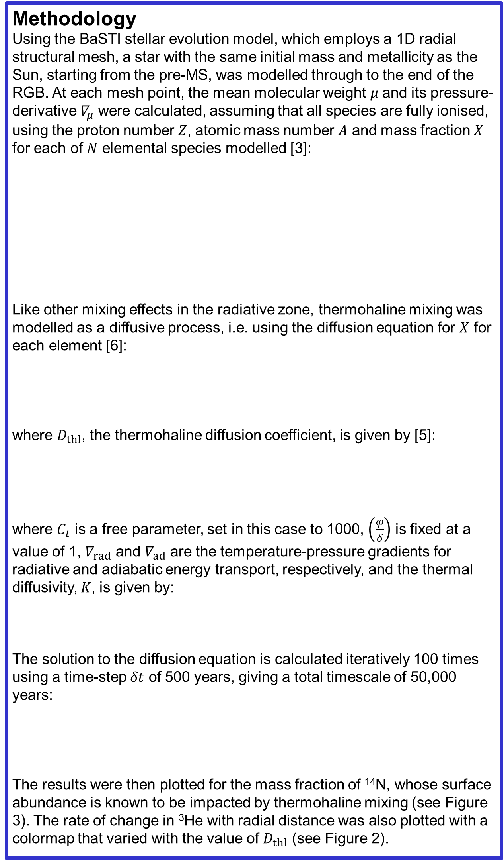
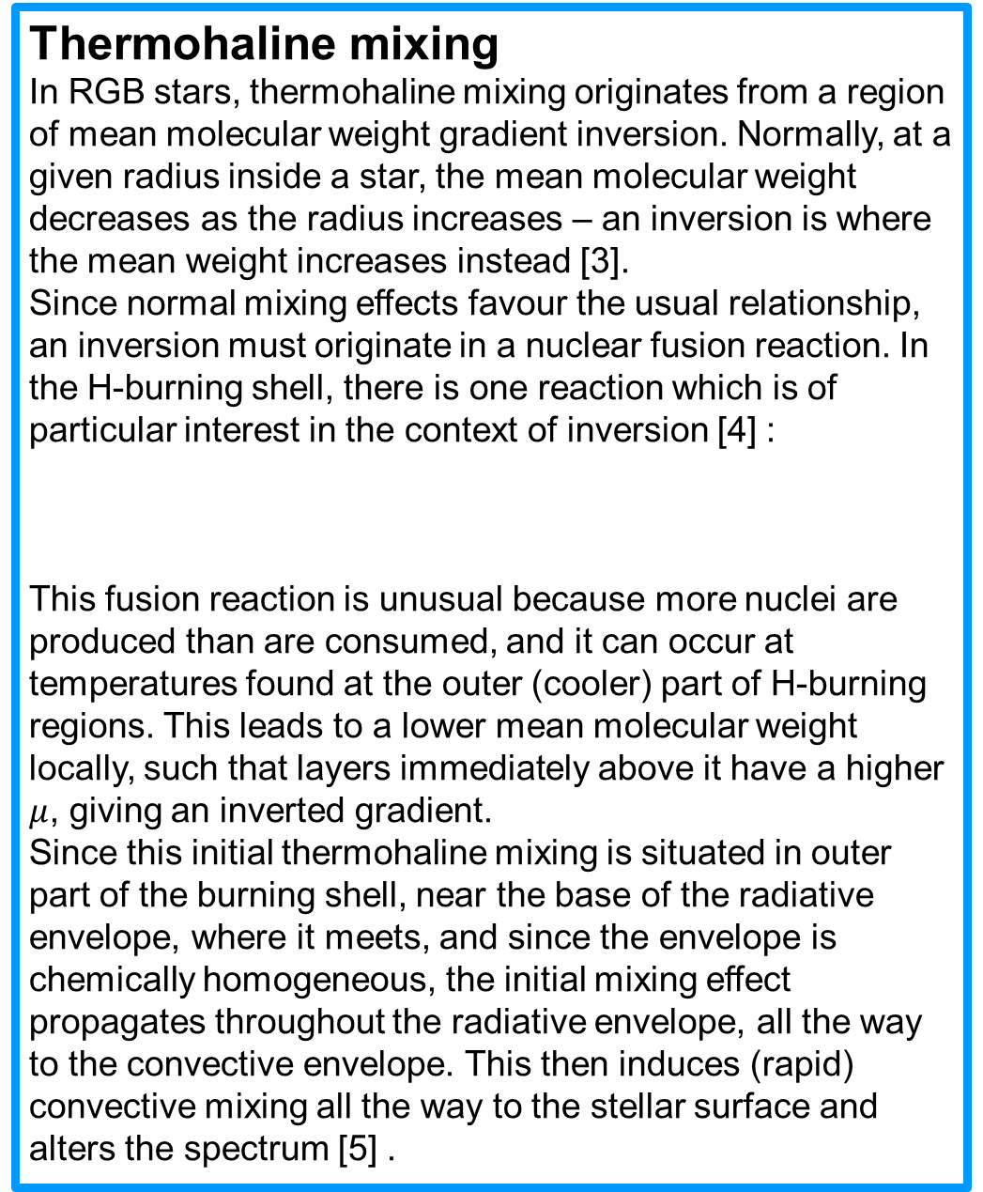
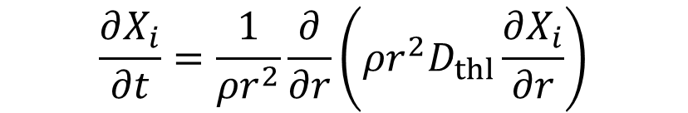
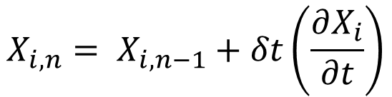
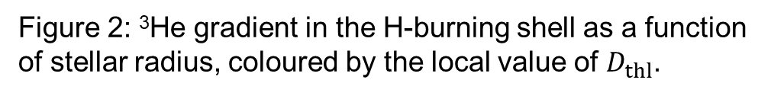


Thermohaline mixing in stellar evolution modelling
Alex Lisboa-Wright, Maurizio Salaris, Santi Cassisi
Astrophysics Research Institute, Liverpool John Moores University
Byrom Street, Liverpool, L3 3AF, UK
Abstract
Linking the observed surface abundances of stars to the initial abundance values is crucial to unveiling the chemical evolution history of galaxies. Red giant branch (RGB) stars are considered to be particularly good probes, because they can reach very high luminosities, hence they are resolvable also in relatively distant galaxies. The start of the RGB represents the end of core hydrogen (H)-burning, followed by an episode of significant convective mixing over all layers
between the core and the stellar surface. RGB observations in nearby star clusters, whose initial chemical composition can be inferred from other types of stars, show that some additional mechanism beyond standard convection (accounted for in stellar models) alters the RGB surface abundances. It is generally hypothesised that thermohaline mixing, a process already known in oceanography and laboratory experiments, is responsible for this extra mixing, due to a local molecular weight gradient inversion from ³He fusion developing in the radiatively stable stellar interiors, located between the hydrogen fusion shell and the convective envelope. This work in progress aims at modelling thermohaline mixing in RGB stars using a well established stellar evolution simulation code (BaSTI), developed at the ARI in collaboration with the Observatory of Abruzzo (Italy). These first preliminary results will show the development of the thermohaline mixing in a RGB model and the calculation of the associated diffusion coefficient.
Thermohaline mixing
In RGB stars, thermohaline mixing originates from a region of mean molecular weight gradient inversion. Normally, at a given radius inside a star, the mean molecular weight decreases as the radius increases – an inversion is where the mean weight increases instead [3].
Since normal mixing effects favour the usual relationship, an inversion must originate in a nuclear fusion reaction. In the H-burning shell, there is one reaction which is of particular interest in the context of inversion [4] :
This fusion reaction is unusual because more nuclei are produced than are consumed, and it can occur at temperatures found at the outer (cooler) part of H-burning regions. This leads to a lower mean molecular weight locally, such that layers immediately above it have a higher $μ$, giving an inverted gradient.
Since this initial thermohaline mixing is situated in outer part of the burning shell, near the base of the radiative envelope, where it meets, and since the envelope is chemically homogeneous, the initial mixing effect propagates throughout the radiative envelope, all the way to the convective envelope. This then induces (rapid) convective mixing all the way to the stellar surface and alters the spectrum [5] .
Methodology
Using the BaSTI stellar evolution model, which employs a 1D radial structural mesh, a star with the same initial mass and metallicity as the Sun, starting from the pre-MS, was modelled through to the end of the RGB. At each mesh point, the mean molecular weight $μ$and its pressure-derivative $∇_{μ}$ were calculated, assuming that all species are fully ionised, using the proton number $Z$, atomic mass number $A$ and mass fraction $X$ for each of $N$ elemental species modelled [3]:
Like other mixing effects in the radiative zone, thermohaline mixing was modelled as a diffusive process, i.e. using the diffusion equation for $X$ for each element [6]:
where $D_{thl}$, the thermohaline diffusion coefficient, is given by [5]:
where $C_{t}$ is a free parameter, set in this case to 1000, $\left(\frac{φ}{δ}\right)$ is fixed at a value of 1, $∇_{rad}$ and $∇_{ad}$ are the temperature-pressure gradients for radiative and adiabatic energy transport, respectively, and the thermal diffusivity, $K$, is given by:
The solution to the diffusion equation is calculated iteratively 100 times using a time-step $δt$ of 500 years, giving a total timescale of 50,000 years:
The results were then plotted for the mass fraction of ¹⁴N, whose surface abundance is known to be impacted by thermohaline mixing (see Figure 3). The rate of change in ³He with radial distance was also plotted with a colormap that varied with the value of $D_{thl}$ (see Figure 2).
RGB
$$μ=\frac{1}{\sum_{i=1}^{i=N}{(Z_{i}+1)\frac{X_{i}}{A_{i}}}}$$
$$3He+3He→4He+21H$$
$$∇_{μ}=\frac{d\ln{μ}}{d\ln{P}}$$
Figure 1: HR diagram for the globular cluster M55/NGC 6809. Source: https://apod.nasa.gov/apod/ap010223.html
$$\frac{∂X_{i}}{∂t}=\frac{1}{ρr^{2}}\frac{∂}{∂r}\left(ρr^{2}D_{thl}\frac{∂X_{i}}{∂r}\right)$$
Introduction
Stars in a cluster or galaxy are generally displayed on a Hertzsprung-Russell or colour-magnitude diagram (see Figure 1 for an example). Stars are detected and classified using their spectra, which are produced at the stellar surface and give direct information on the composition of the surface and atmosphere only (at the present time). Interior compositions are calculated using theoretic stellar evolution models, such as BaSTI [1][2] .
A star’s RGB phases begins at the end of its main-sequence (MS) life, as the core H-burning phases out. The star undergoes an expansion of its surface layers, during which its convective envelope expands inwards until it reaches the He-core, a process known as the first dredge-up (FDU). Convective mixing occurs on very rapid timescales, so the surface chemical composition is altered, with a higher fraction of fusion products than before. The convective envelope retreats towards the surface before stabilising as the H-burning shell ignites, beginning the RGB phase in earnest.
For a typical RGB star, the interior structure can be summarised (from the centre outwards) as: Degenerate He core, H-burning layer, radiative envelope, convective envelope, stellar surface.
$$D_{thl}=C_{t}K\left(\frac{φ}{δ}\right)\frac{∇_{μ}}{∇_{rad}−∇_{ad}}$$
$$K=\frac{4acT^{3}}{3κρ^{2}c_{P}}$$
$$X_{i,n}= X_{i,n−1}+δt\left(\frac{∂X_{i}}{∂t}\right)$$
Figure 2: ³He gradient in the H-burning shell as a function of stellar radius, coloured by the local value of $D_{thl}$.
Results & future work
Figure 3 shows the effect of thermohaline mixing on the time variations on the mass fraction of nitrogen in the H-burning shell. It can be seen that, in the outer part of this shell, thermohaline mixing is viable and is able to produce large effects on extremely short timescales relative to the RGB lifetime (which is hundreds of millions of years for this type of star). Looking at Figure 2, the region of mixing activity coincides with the region in which ³He is being consumed, confirming the physical origin of the mean molecular weight inversion. So far, the right-hand side of the diffusion equation has been kept independent of time, which will change following implementation of thermohaline mixing into the BaSTI modelling code, as changes in abundance will propagate over time rather than remain confined in the same region. This will allow any relevant changes in surface composition to be calculated. The new modelled spectra will then be compared to observed RGB spectra.
References
[1] Pietrinferni A., Cassisi S., Salaris M. and Castelli F. 2004, ApJ 612 168
[2] Cassisi S. & Salaris M. 1997, MNRAS 285 593
[3] Salaris M. and Cassisi S. 2017 RSOS 4 170192
[4] Ulrich, R. K. 1972, ApJ 172 165
[5] Lattanzio J. C., Siess L., Church R. P. et al 2015, MNRAS 446 2673
[6] Cantiello M. & Langer N. 2010, A&A, 521, A9
Figure 3: Mass fraction of ¹⁴N plotted as a function of stellar radius, focussed on the H-burning shell region.

